Slide 1
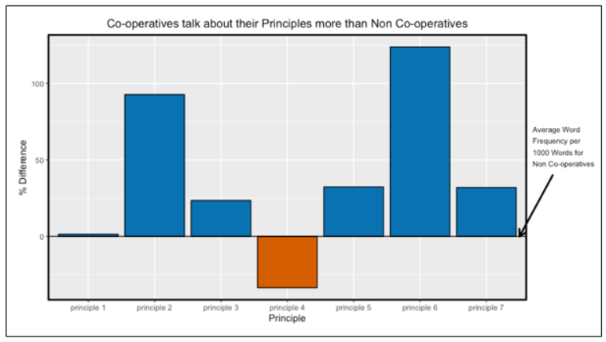
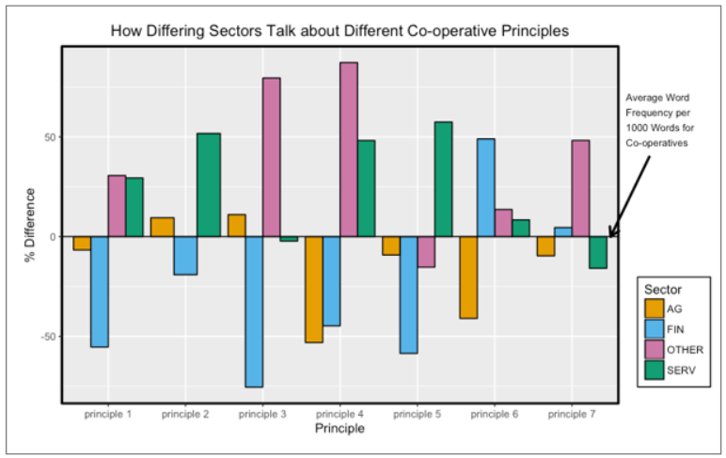
Talking the talk: Do co-operative organizations align themselves with co-operative values more than non-co-operatives?
Background- At The Co-operators, we pride ourselves in our focus/mindfulness of co-operative values within our organization. We discuss co-operative values as an organizational strength tha
Goal/objective - hfgdhsfghsafdhfdahfadhsfgdhfgdahdhagdhfgdhsafgdhsfgdhjgfdajhgafdrsjhgfdjhgtfrsajhgfrsahgfdrsjhagrjhgsa
Approach: We visited the organization websites of each of the member owners of The Co-operators Financial Services Limited. On each website, we looked for descriptive, ‘about us’ organization information on the homepage or on any page (or nested set of pages) with a direct link from the homepage. We extracted the descriptive organization text content from each page. We then identified a similar non-co-operative organization to each co-operative member owner of The Co-operators, by industry, products/services offered, region, and size (in that order of relative importance). We extracted the descriptive organization text content from each non-co-operative competitor using the same approach that was used for co-operative organizations. We then analyzed the text of the ‘about us’ webpage content for co-operative and non-co-operative organizations, calculating word use frequencies for each organization. Here we present the results of the strongest differences in word use between co-operatives and non-co-operatives by industrial sector, the relative differences in frequencies of words related to each of the 7 principles of co-operative organizations between co-operatives and non-co-operatives. And the differences in the frequencies with which co-operatives from different industrial sectors use language related to each of the 7 co-operative principles.
Co-operative Principles: The co-operative principles are guidelines by which co-operatives put their values into practice.
1. Voluntary and Open Membership: Co-operatives are voluntary organisations, open to all persons able to use their services and willing to accept the responsibilities of membership, without gender, social, racial, political or religious discrimination.
2. Democratic Member Control: Co-operatives are democratic organisations controlled by their members, who actively participate in setting their policies and making decisions. Men and women serving as elected representatives are accountable to the membership. In primary co-operatives members have equal voting rights (one member, one vote) and co-operatives at other levels are also organised in a democratic manner.
3. Member Economic Participation: Members contribute equitably to, and democratically control, the capital of their co-operative. At least part of that capital is usually the common property of the co-operative. Members usually receive limited compensation, if any, on capital subscribed as a condition of membership. Members allocate surpluses for any or all of the following purposes: developing their co-operative, possibly by setting up reserves, part of which at least would be indivisible; benefiting members in proportion to their transactions with the co-operative; and supporting other activities approved by the membership.
4. Autonomy and Independence: Co-operatives are autonomous, self-help organisations controlled by their members. If they enter into agreements with other organisations, including governments, or raise capital from external sources, they do so on terms that ensure democratic control by their members and maintain their co-operative autonomy.
5. Education, Training and Information: Co-operatives provide education and training for their members, elected representatives, managers, and employees so they can contribute effectively to the development of their co-operatives. They inform the general public - particularly young people and opinion leaders - about the nature and benefits of co-operation.
6. Co-operation among Co-operatives: Co-operatives serve their members most effectively and strengthen the co-operative movement by working together through local, national, regional and international structures.
7. Concern for Community: Co-operatives work for the sustainable development of their communities through policies approved by their members.
Agricultural co-operatives use language related to autonomy and independence, and co-operation among co-operatives less than other co-operatives
Finan

